Slide 1
Exploring YouTube Metrics

Slide 2
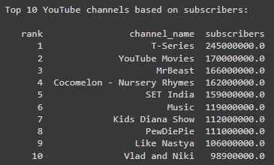
Top 10 YouTube channels with most subscribers

Slide 3
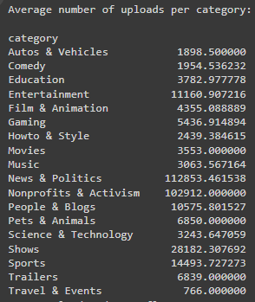
Category wise analysis
Highest number of subscribers
‘Shows’ with an average of 41615384 subscribers
Average uploads in each category

Slide 4
Top 5 countries with most channels
United States | 435
India | 167
Brazil | 62
United Kingdom | 43
Mexico | 33

Slide 5
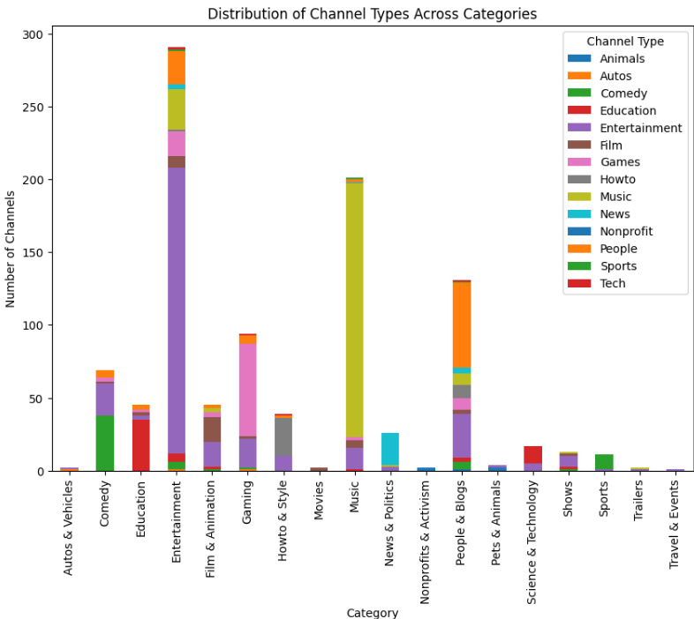
Distribution of channels across different categories
The category with the most channels is “Entertainment”
The category with the second most channels is “Music”

Slide 6
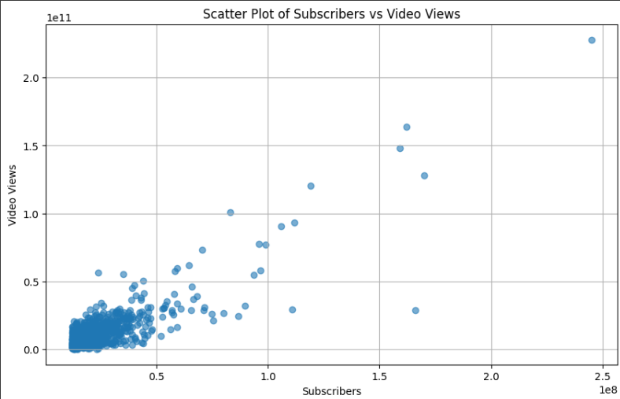
Number of subscribers vs Video Views
Greater the number of subscribers, greater the video views

Slide 7
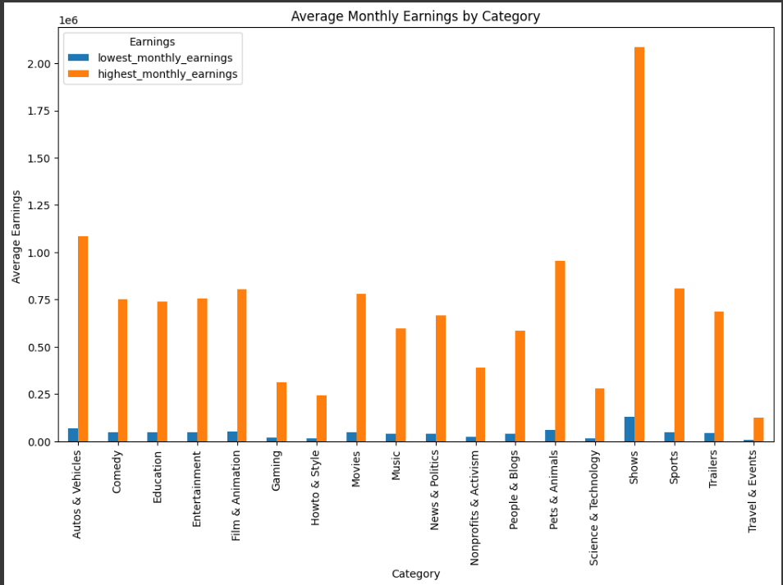
Monthly Earnings
‘Shows’ has the highest monthly earnings on aggregate

Slide 8
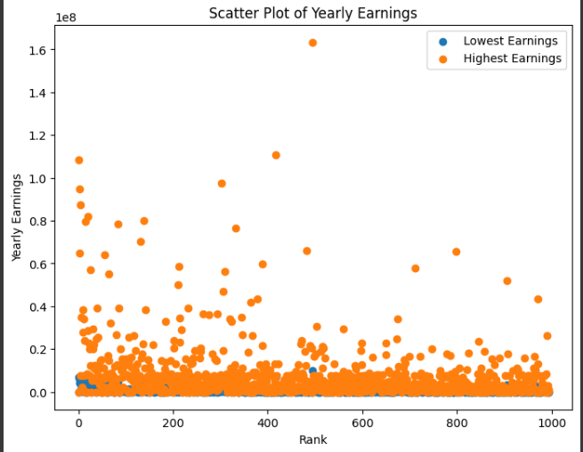
Yearly Earnings
There are a few outliers in the ‘Yearly Earnings’ for YouTube Channels

Slide 9
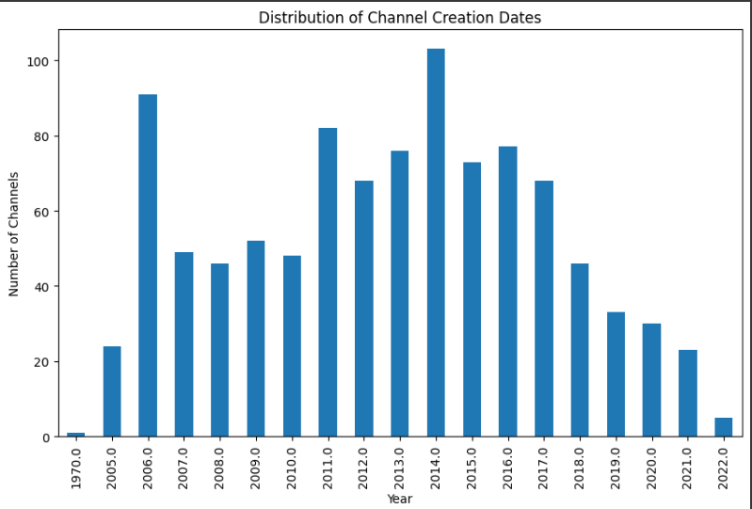
Channel creation year
Many channels were created during the years 2006, 2011 and 2014
There has been a decline in the number of channels created recently
This could be due to the increased popularity of other social media platforms

Slide 10
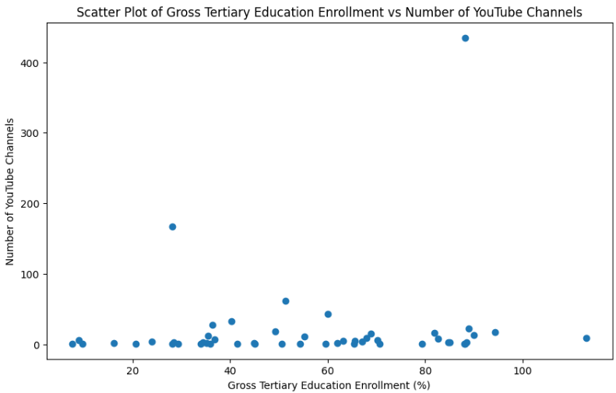
Education factor
Looking at the graph, it can be said that the higher the education of a country, more the YouTube channels
There are a few exceptions

Slide 11
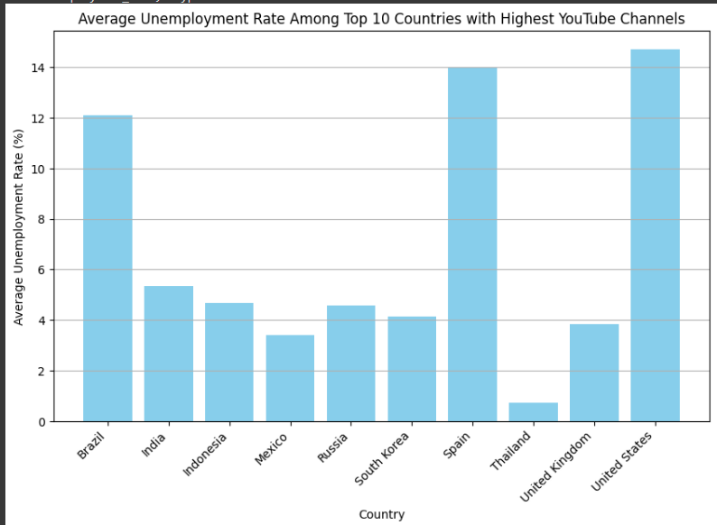
Unemployment rate in countries with most YouTube channels
The unemployment rate is quite high for some countries with many YouTube channels
This could mean people are solely focusing on their YouTube channel and making a living out of that

Slide 12
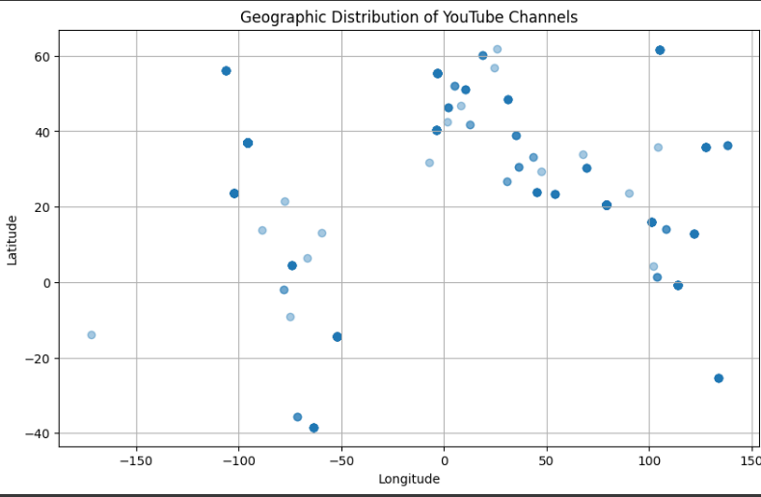
Geographic distribution of YouTube Channels
Looking at the scatter plot, we can see that the channels are distributed all over the world, with higher concentrations in some regions such as North America, Europe, and Asia

Slide 13
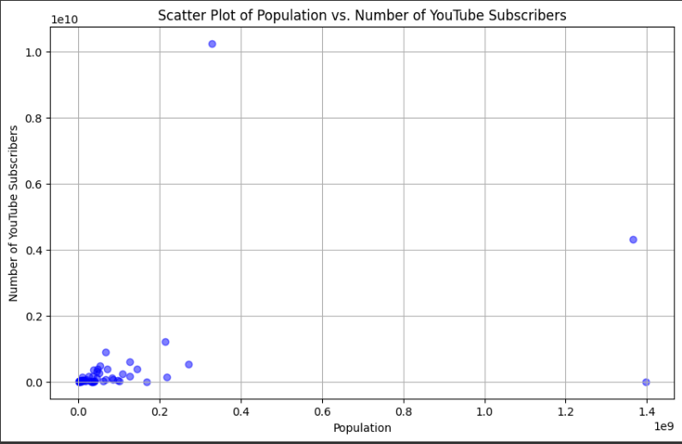
Population vs Number of Subscribers
Greater the population, more the number of subscribers

Slide 14
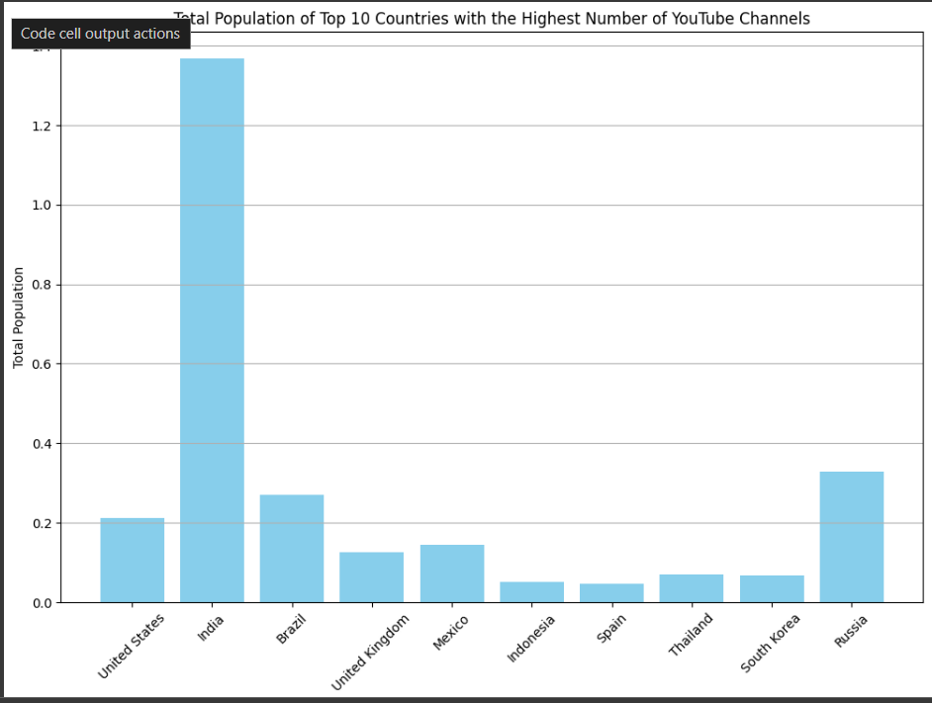
Top 10 countries with highest number of YouTube channels vs their population

Slide 15
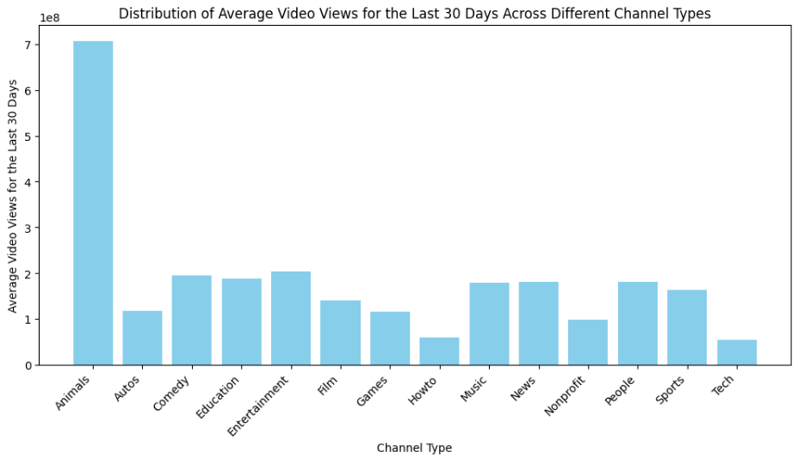
Views for the last 30 days for different categories
‘Animals’ category has got the most views for the past 30 days
‘Tech’ category has got the least views for the past 30 days

Slide 16
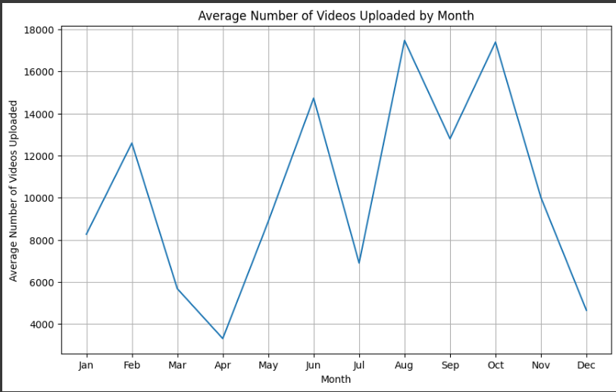
Seasonal Trends
The graph shows an upward trend in the average number of videos uploaded by month.
There is a slight increase in the number of videos uploaded during the months (June, August, October)

Slide 17
THANK YOU

